Slide 1

15EC496L Major Project
Review - 3
On
Remotely Monitoring the Condition Of Solar Power System
Using Arduino
By
Mohammed Furquan Hussain (RA1711004010205)
Mohammed Samran Ghouse (RA1711004010033)
Aftab Nadaf (RA1711004010580)
Under the guidance of
Mrs.S.T.Aarthy
Assistant Professor (O.G), Department of ECE
SRM Institute of Science & Technology, Kattankulathur, Tamil Nadu- 603203

Slide 2
INDEX
S No. | Slide No. | Content / Heading
1 | 3 | Introduction
2 | 4 - 5 | Literature Review
3 | 6 | Problem Statement
4 | 7 | Objective
5 | 8 | Novelty
6 | 9 | Hardware / Software Used
7 | 10 | System / Architecture diagram (Proposed)
8 | 11 | Methodology (Flow Chart)
9 | 12 - 19 | Hardware Description & Specifications
10 | 21-28 | Work Plan and Working Model
11 | 29 - 32 | Program (Embedded C for Arduino)
12 | 33 | Output
13 14 | 34 35 | Demo Poster
14 | 36 | References

Slide 3
Introduction
Using the Internet of Things Technology for Monitoring solar power generation can significantly increase the performance and maintenance of the solar panel.
This Project is based on implementation of new cost actual methodology based on IoT to remotely monitoring a solar plant for performance evaluation. This will smooth the way of preventive maintenance, fault detection of the solar panel in addition to real time monitoring.
Wireless monitoring of energy efficiency of SPV system using the state of the art instrumentation through IOT AND Arduino will help the users in taking various preventive steps by which consistency on increased energy efficiency can be maintained.
This monitoring is done through Arduino using Web server. Smart Monitoring displays daily usage of renewable energy.
This helps the user to study of energy usage. Analysis impacts on the renewable energy usage.
The influence of contact thermal resistances is evaluated by the Open-Circuit Voltage (OCV) method used for the Maximum Power Point Tracking (MPPT).
MPPT or Maximum Power Point Tracking is algorithm that included in charge controllers used for extracting maximum available power from PV module under certain conditions. The voltage at which PV module can produce maximum power is called maximum power point (or peak power voltage) and Open-circuit voltage is the difference of electrical potential between two terminals of a device when disconnected from any circuit.

Slide 4
Literature Review
S No. | Title | Year | Author Name | Contents
1 | REVIEW ON SOLAR POWER REMOTE MONITORING AND CONTROLLING USING IoT | 2018 | Dr.J.Geetha Ramani, S.Mohana Sowmiya, S.Mirunalinii, U. Nandha Kumar | The Internet of Things (IoT) has a vision in which the internet extends into the real world, which incorporates eve-ryday objects. Solar power remote monitoring and controlling using IoT is to monitor and control the power in the solar panels from anywhere in the world. Using the Internet of Things Technology for supervising solar photovoltaic power generation can greatly enhance the performance, monitoring and maintenance of the plant. With advancement of technologies the cost of renew-able energy equipments is going down globally encouraging large scale solar or photovoltaic installations. The solar tracking is used to increase the power consumption according to sun direction. The influence of contact thermal resistances is evaluated by the Open-Circuit Voltage (OCV) method used for the Maximum Power Point Tracking(MPPT).

Slide 5
2 | Photovoltaic Remote Monitoring System Based on GSM | 2013 | Farihah Shariff, Nasrudin Abd Rahim, Hew Wooi Ping | In remote area, the need for monitoring PV system is crucial to ensure stable PV power delivery. This paper describes the hardware and software design for PV monitoring system in remote area. The monitoring system is equipped with voltage sensor, current sensor, temperature sensor and irradiation sensor and GSM modem for data transmission.
3 | Implementation of IoT based PV Monitoring System with Message Queuing Telemetry Transfer protocol and Smart Utility Network | 2012 | Chang-Sic Choi, Jin-Doo Jeong, Jinsoo Han, Wan-Ki Park, Il-Woo Lee | For the IoT based PV monitoring system, we developed IoT gateway based on inexpensive Raspberry pi hardware and adopted the Message Queuing Telemetry Transfer (MQTT) protocol at IoT gateway and Smart Phone. And also we can down the cost by using the Smart Utility Network(SUN) communication of the license-exempt band which is sub-1Ghz band.

Slide 6
PROBLEM STATEMENT
In traditional, to manage a lot of solar panels in green power plants is very difficult and inefficient.
Because one panel set needs a digital power meter, it is very expensive to use the panel to collect all data.
To cope with this problem, we proposed a remote monitoring system of solar panels via Arduino, in which the parameters of environment and panel voltage would be sent to the Smart Analysis Database System.
Then we can monitor the health of the Solar Plant by using the GSM platform anywhere and anytime.
The administrator not only can use a mobile device to maintain the solar plant via GSM Network through IOT, and also receive the message immediately when the status of solar panel is abnormal.

Slide 7
OBJECTIVE
The main objectives of this proposed health monitoring system for solar power system is to:-
Eliminate the need for physical (or) in-person maintenance for solar panels.
Automatic measurement of current, voltage and efficiency and send it through network carrier wirelessly through GSM module.
Auto on / off w.r.t time of the day.
To detect unusual readings for the solar panels.
To transmit data through IoT on network Carrier (GSM).
To process and detect faulty readings automatically through Arduino IDE.

Slide 8
NOVELTY
EXISTING SYSTEM | PROPOSED SYSTEM
Monitoring system is not implemented. Manually checking the output values of the solar panel through older techniques like multimeter (digital meter). No real time comparison No control for the user wirelessly Drawbacks Maintenance is difficult. Life of the solar panel is decreases eventually. | Monitoring system is implemented using MPPT (Maximum Power Point Tracking) Algorithm and OCV (Open Circuit Voltage) Sensors are used to check the output values of the solar panel to know the life. Real time comparison along with and low efficiency indication is given. Provides wireless control Advantages Maintenance is easy. Increases the life of the solar panel.

Slide 9
HARDWARE REQUIREMENTS:
ARDUINO UNO
SOLAR PANEL
VOLTAGE SENSOR
CURRENT SENSOR
RELAY
BATTERY
GSM MODULE
RTC
DC MOTOR
LCD DISPLAY
IOT MODULE
POWER SUPPLY
SOFTWARE REQUIREMENTS:
Arduino IDE
Embedded C

Slide 10
System / Architecture Diagram
SOLAR PANEL
BATTERY
POWER SUPPLY
ARDUINO UNO
VOLTAGE SENSOR(2)
LCD
DISPLAY
RELAY
GSM MODULE
CURRENT SENSOR
IOT
MODULE
DC MOTOR(5V)
RTC

Slide 11
METHODOLOGY
START
FLOW CHART FOR PROPOSED MODEL
Initiate Arduino UNO
Initiate SIM 900A GSM Module
Establish connection to internet using AT commands
Is connection established?
Send error message
Take input from Solar Panel
Generate an IP address
Read analogue pin values
Send to GSM module via serial Communication Protocol
Send the data to the Internet
Store the data

Slide 12
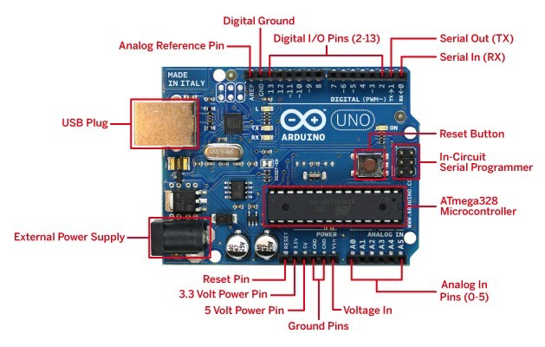
Hardware Description & Specifications
1. Arduino
Microcontroller | ATmega328P
Operating Voltage | 5V
Input Voltage (recommended) | 7-12V
Input Voltage (limit) | 6-20V
Digital I/O Pins | 14 (of which 6 provide PWM output)
PWM Digital I/O Pins | 6
Analog Input Pins | 6
DC Current per I/O Pin | 20 mA
DC Current for 3.3V Pin | 50 mA
Flash Memory | 32 KB (ATmega328P) of which 0.5 KB used by boot loader
SRAM | 2 KB (ATmega328P)
EEPROM | 1 KB (ATmega328P)
Clock Speed | 16 MHz
LED_BUILTIN | 13
Length | 68.6 mm
Width | 53.4 mm
Weight | 25 g

Slide 13
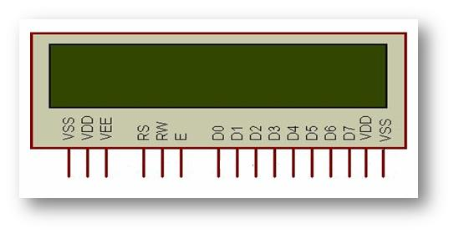
2. Liquid Crystal Display
PIN NO. | FUNCTION | NAME
1 | Ground (0V) | Ground
2 | Supply voltage; 5V (4.7V – 5.3V) | VCC
3 | Contrast adjustment; the best way is to use a variable resistor such as a potentiometer. The output of the potentiometer is connected to this pin. Rotate the potentiometer knob forward and backwards to adjust the LCD contrast. | Vo / VEE
4 | Selects command register when low, and data register when high | RS (Register Select )
5 | Low to write to the register; High to read from the register | Read/write
6 | Sends data to data pins when a high to low pulse is given; Extra voltage push is required to execute the instruction and EN(enable) signal is used for this purpose. Usually, we make it en=0 and when we want to execute the instruction we make it high en=1 for some milliseconds. After this we again make it ground that is, en=0. | Enable
7 | 8-bit data pins | DB0
8 |  | DB1
9 |  | DB2
10 |  | DB3
11 |  | DB4
12 |  | DB5
13 |  | DB6
14 |  | DB7
15 | Backlight VCC (5V) | Led+
16 | Backlight Ground (0V) | Led-

Slide 14
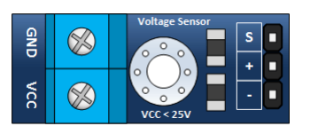
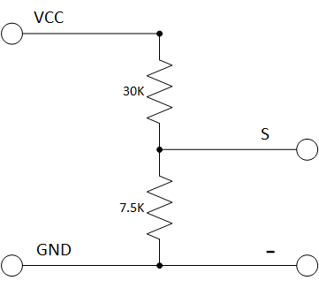
3. Voltage Sensor
SPECIFICATIONS: Divider ratio: 5:1 Resistor Tolerance: 1% Max input voltage: 25V Resistor Value: 30K/7.5K Ohm Pin out: INPUT 1....GND 2....0-25V OUTPUT 1...Sense 2...N/C 3...GND

Slide 15
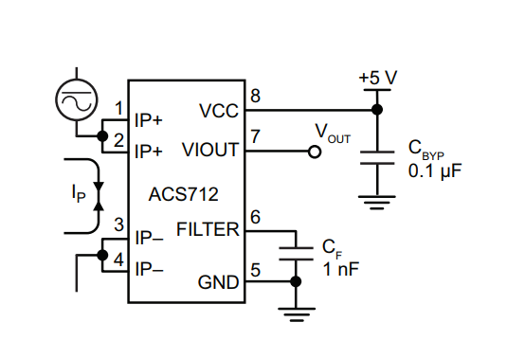
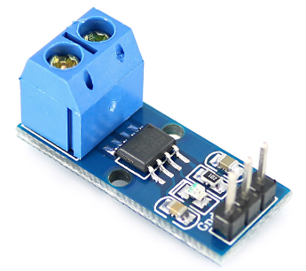
4. ACS712 & Bi-CMOS Hall IC
The device consists of a precise, low-offset, linear Hall circuit with a copper conduction path located near the surface of the die.
Applied current flowing through this copper conduction path generates a magnetic field which the Hall IC converts into a proportional voltage.
Device accuracy is optimized through the close proximity of the magnetic signal to the Hall transducer.
A precise, proportional voltage is provided by the low-offset, chopper-stabilized BiCMOS Hall IC, which is programmed for accuracy after packaging.
The thickness of the copper conductor allows survival of the device at up to 5× overcurrent conditions.
This allows the ACS712 to be used in applications requiring electrical isolation without the use of opto-isolators or other costly isolation techniques.

Slide 16
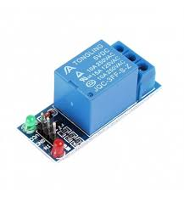
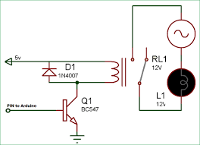
5. Relay
Relays are the primary protection as well as switching devices in most of the control processes or equipment.
All the relays respond to one or more electrical quantities like voltage or current such that they open or close the contacts or circuits.
A relay is a switching device as it works to isolate or change the state of an electric circuit from one state to another.
RELAY CIRCUIT

Slide 17
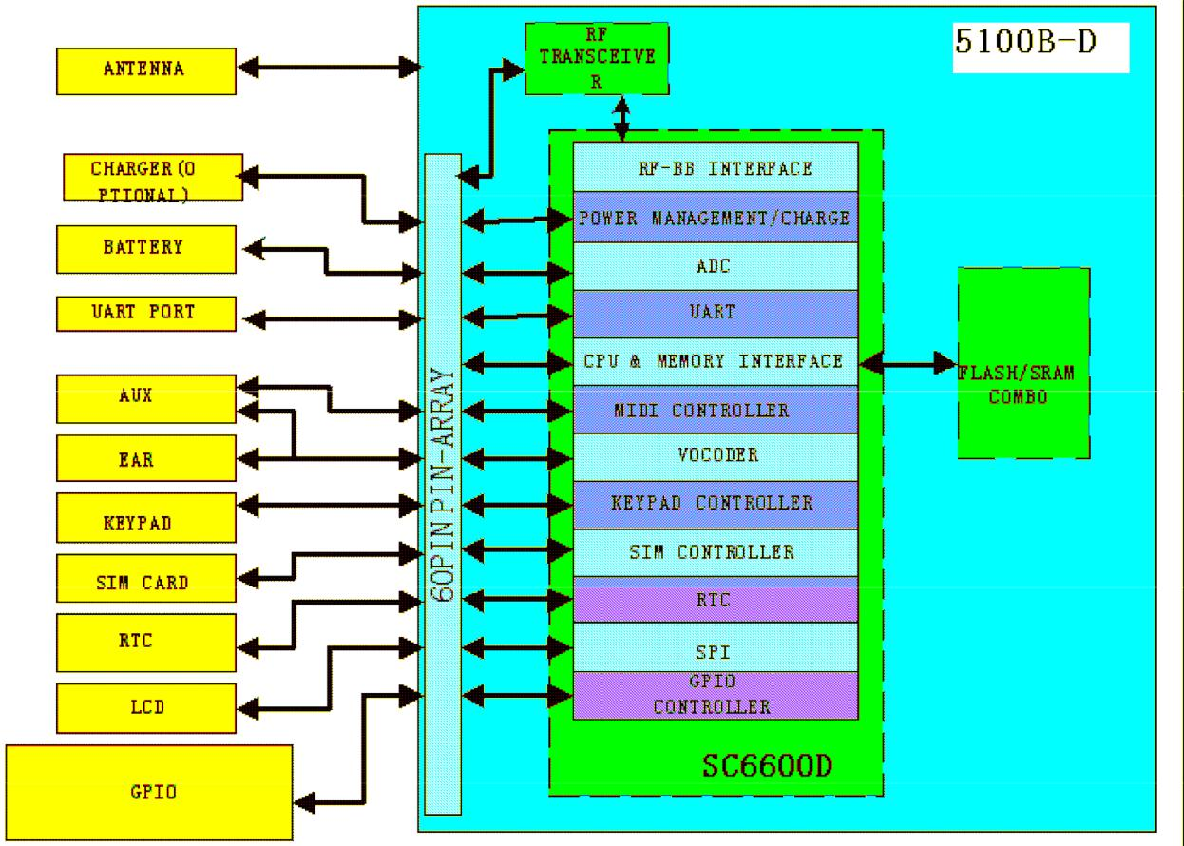
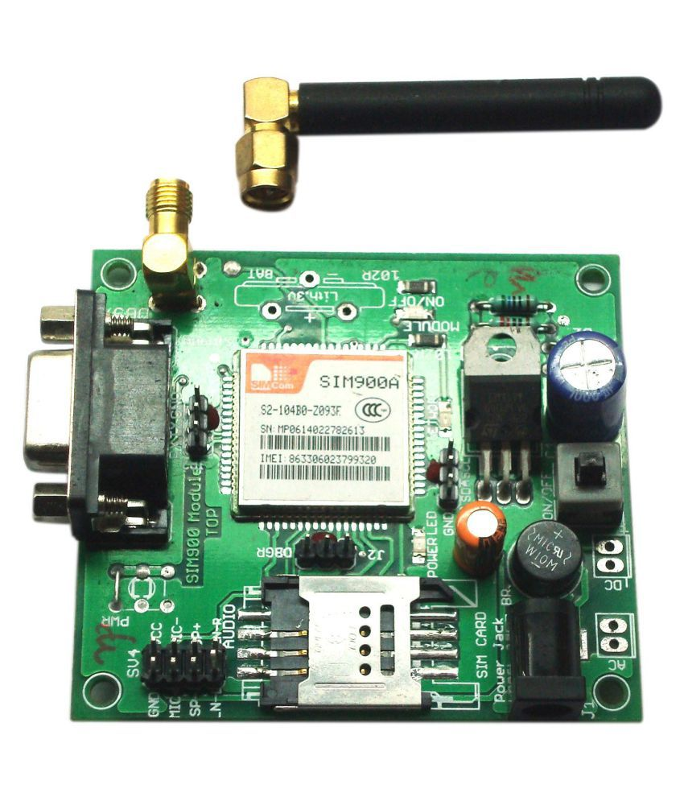
6. GSM MODEM

Slide 18
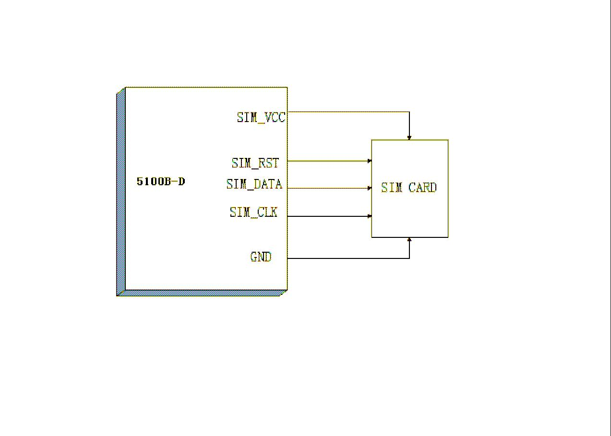
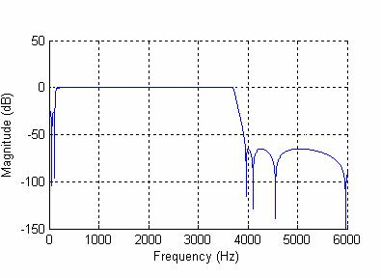
SIM connection (no power control)
Their frequency response curve should be within the mask given by GSM specification (Audio Frequency Response Curve)

Slide 19
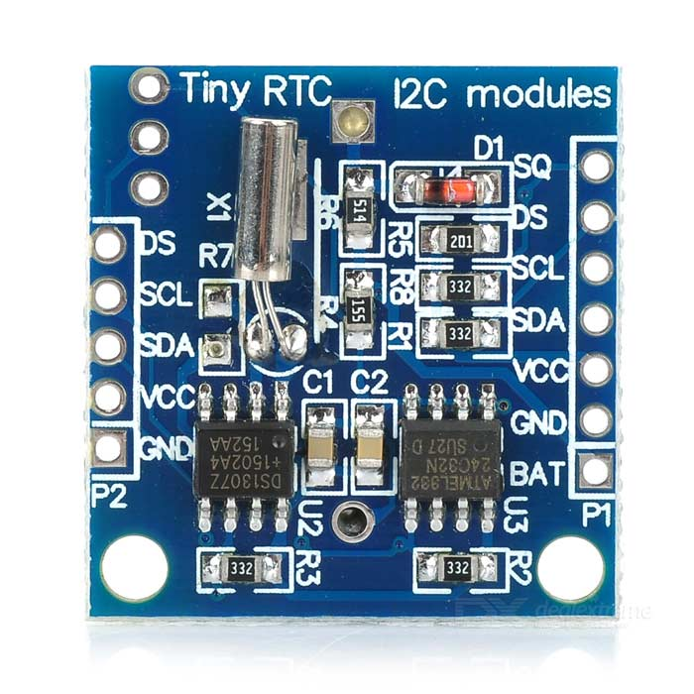
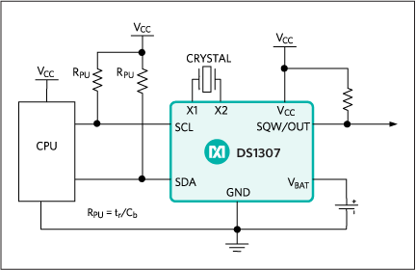
7. DS1307 serial real-time clock (RTC)
DS1307: Typical Operating Circuit
Key Features
Completely Manages All Timekeeping Functions
Real-Time Clock Counts Seconds, Minutes, Hours, Date of the Month, Month, Day of the Week, and Year with Leap-Year Compensation Valid Up to 2100
56-Byte, Battery-Backed, General-Purpose RAM with Unlimited Writes
Programmable Square-Wave Output Signal
Simple Serial Port Interfaces to Most Microcontrollers
I²C Serial Interface
Low Power Operation Extends Battery Backup Run Time
Consumes Less than 500nA in Battery-Backup Mode with Oscillator Running
Automatic Power-Fail Detect and Switch Circuitry
8-Pin DIP and 8-Pin SO Minimizes Required Space
Optional Industrial Temperature Range: -40°C to +85°C Supports Operation in a Wide Range of Applications
Underwriters Laboratories® (UL) Recognized

Slide 20
WORK PLAN
Working on the connection establishment between IOT (GSM Module) link it through carrier and establishing a message centre so the model can send required values on mobile phone.
Obtaining values of Battery Voltage and Solar Voltage to determine functioning of solar panel and battery.
To obtain messages regarding solar panel to check whether the solar panel is working during the day
To obtain messages regarding battery to check whether the battery is working at night.
Our model will carry out seperate operations at day and night. It will also determine the voltage drop in battery (or) solar panel and change automatically.
100% completion and execution of program.

Slide 21
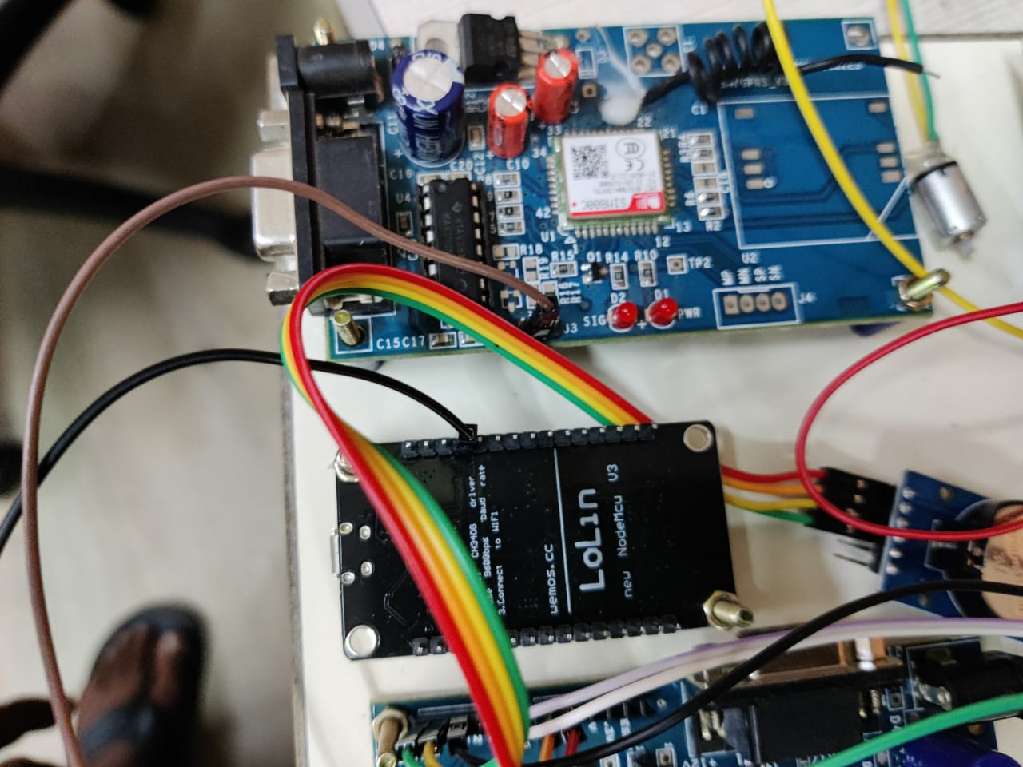
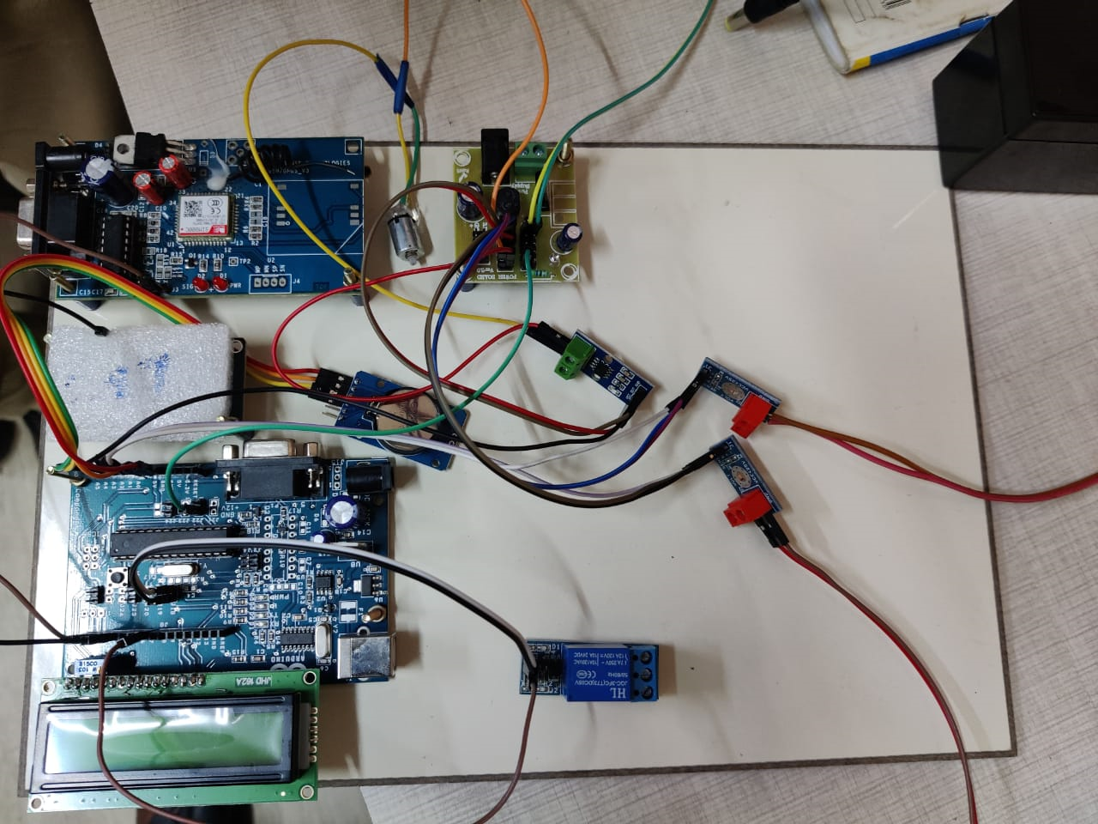
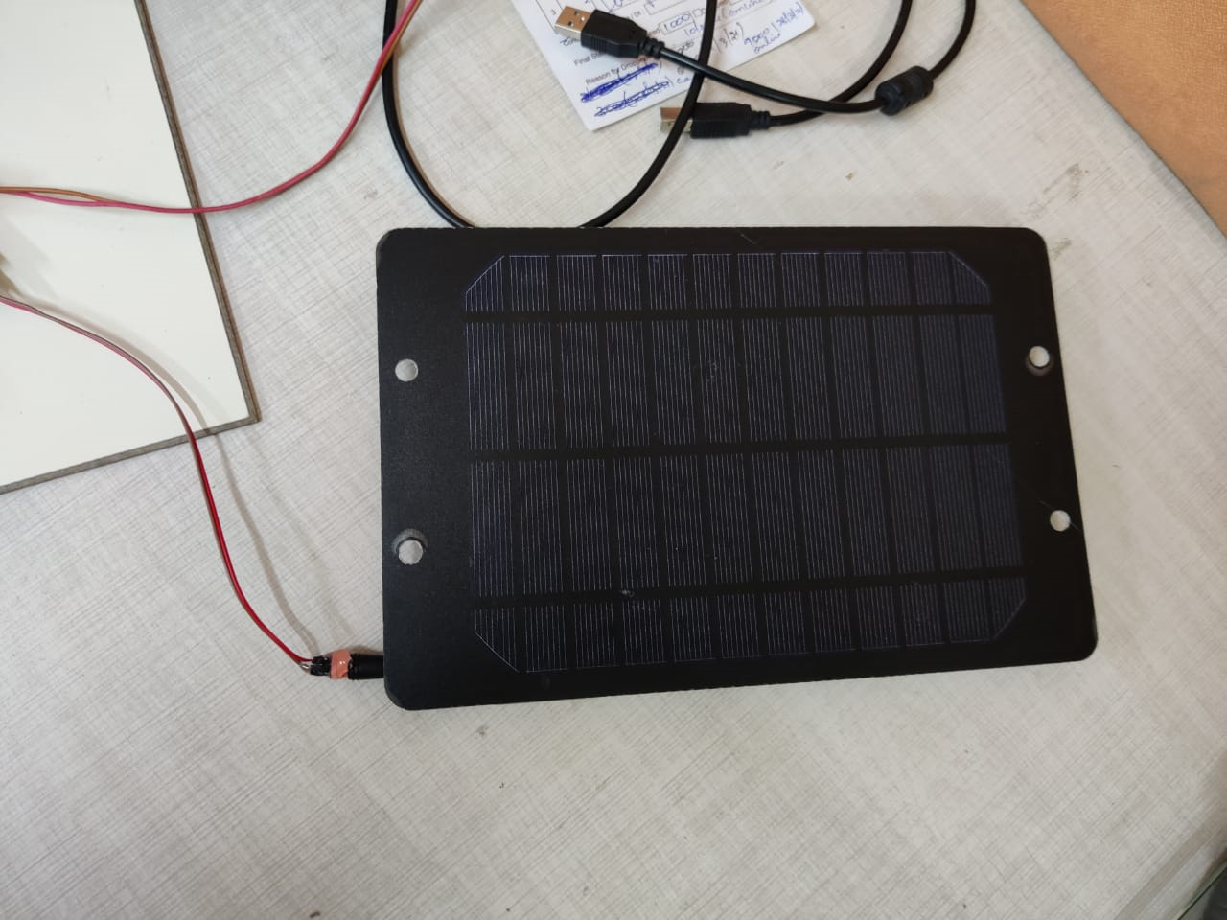
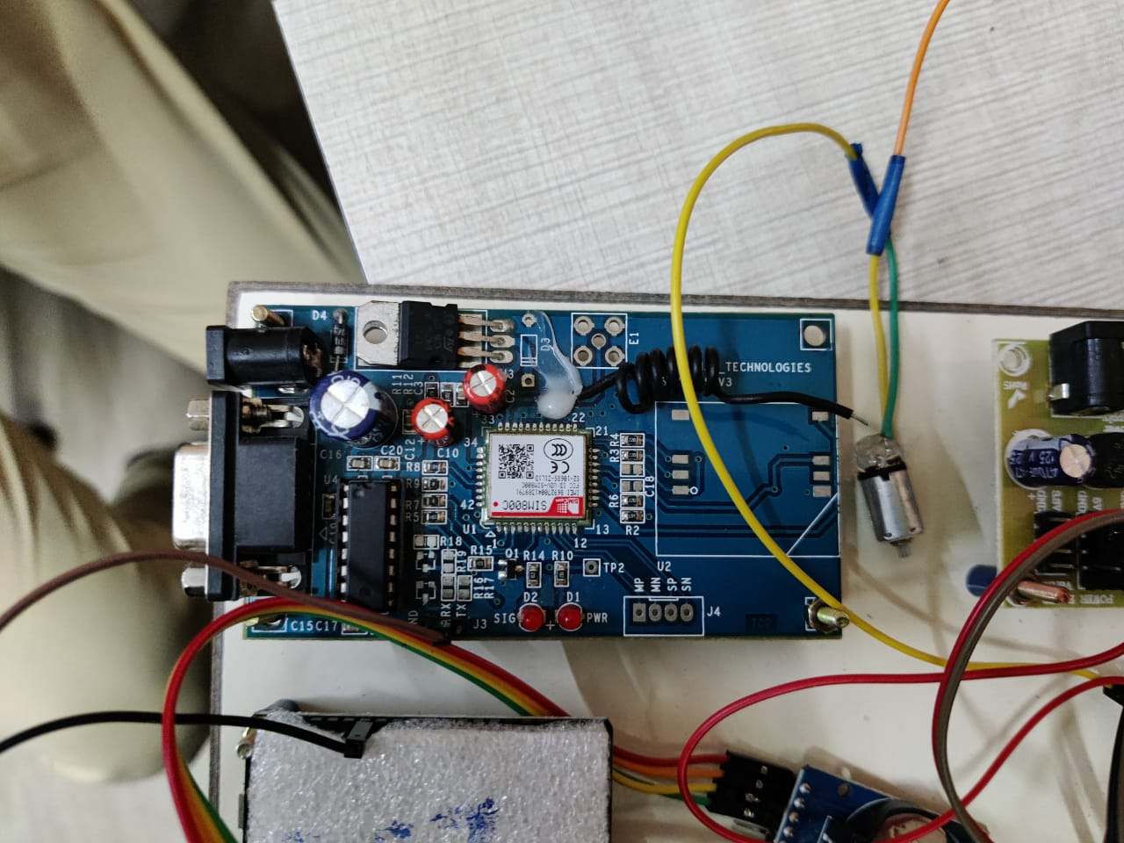
WORKING MODEL

Slide 22
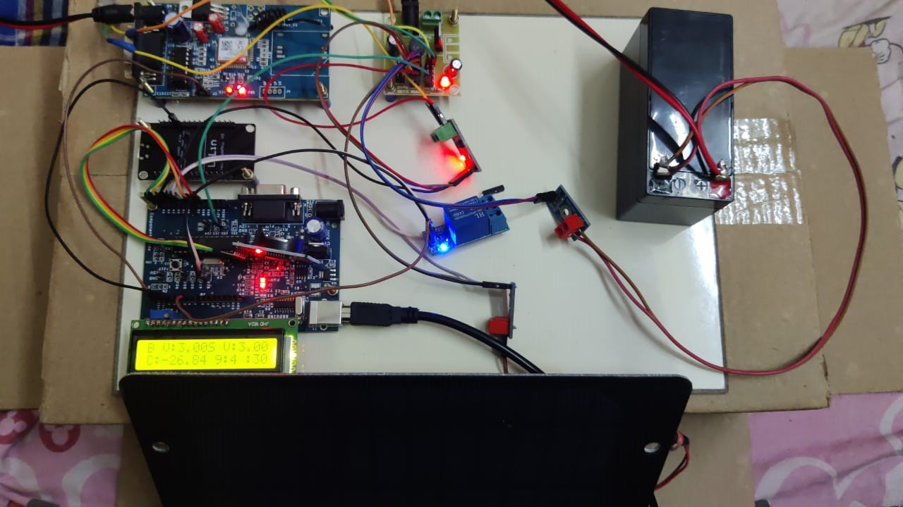

Slide 23
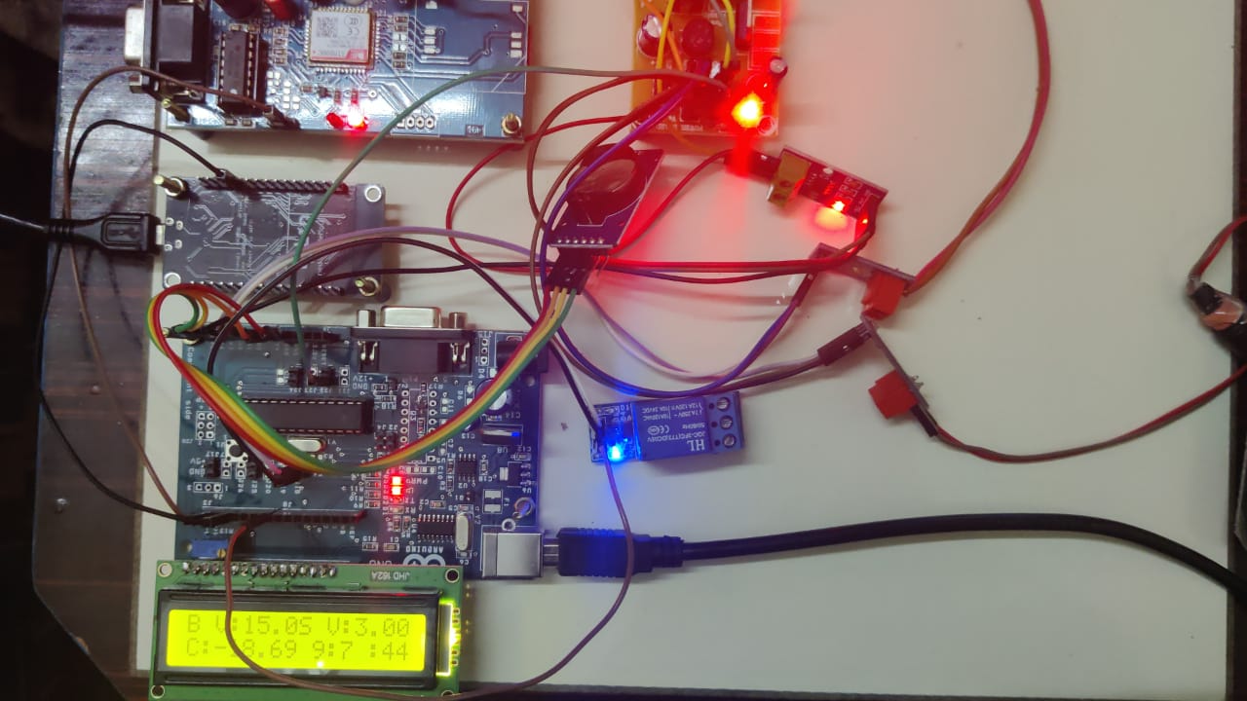

Slide 24
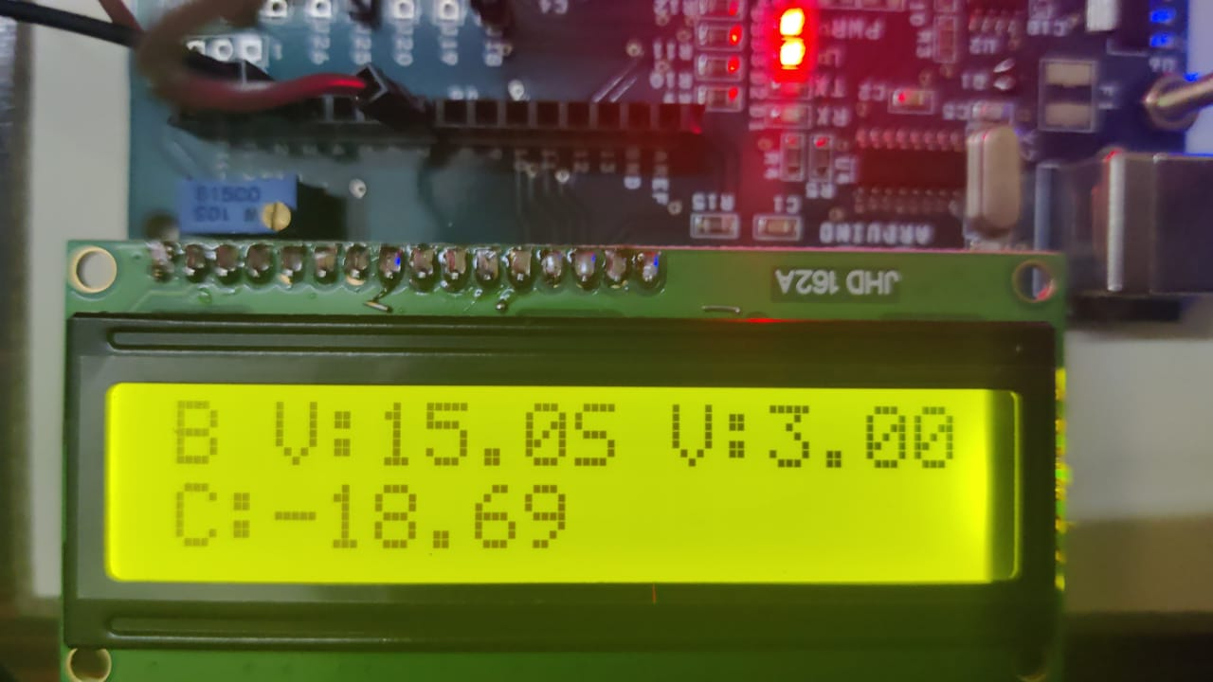

Slide 25
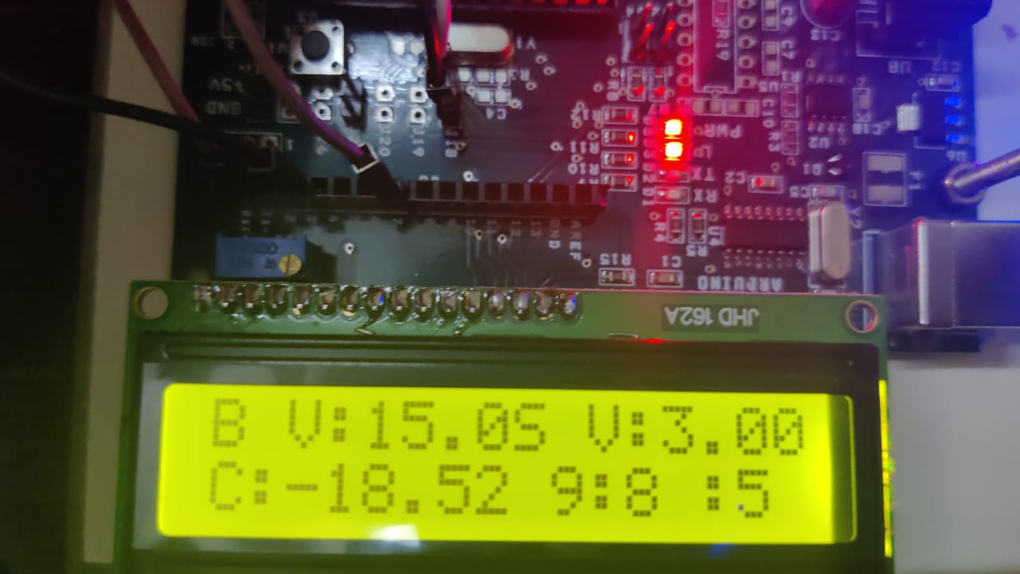

Slide 26
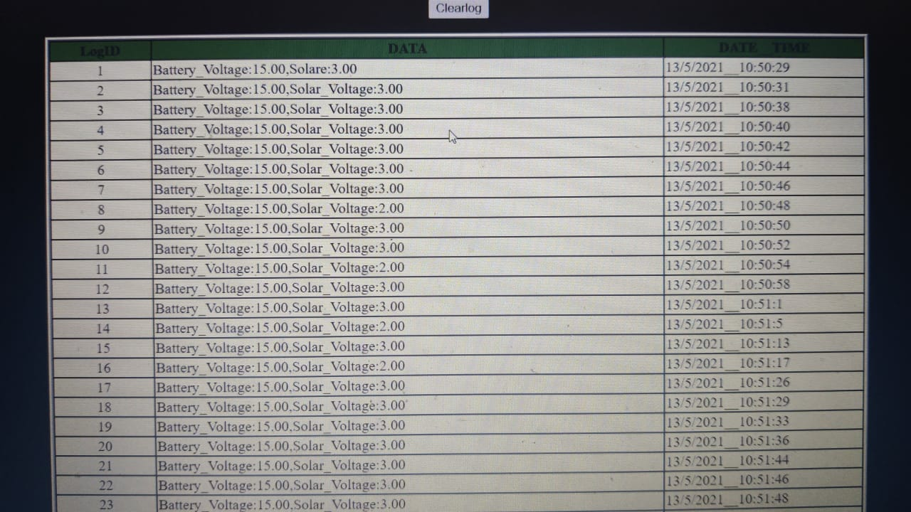

Slide 27
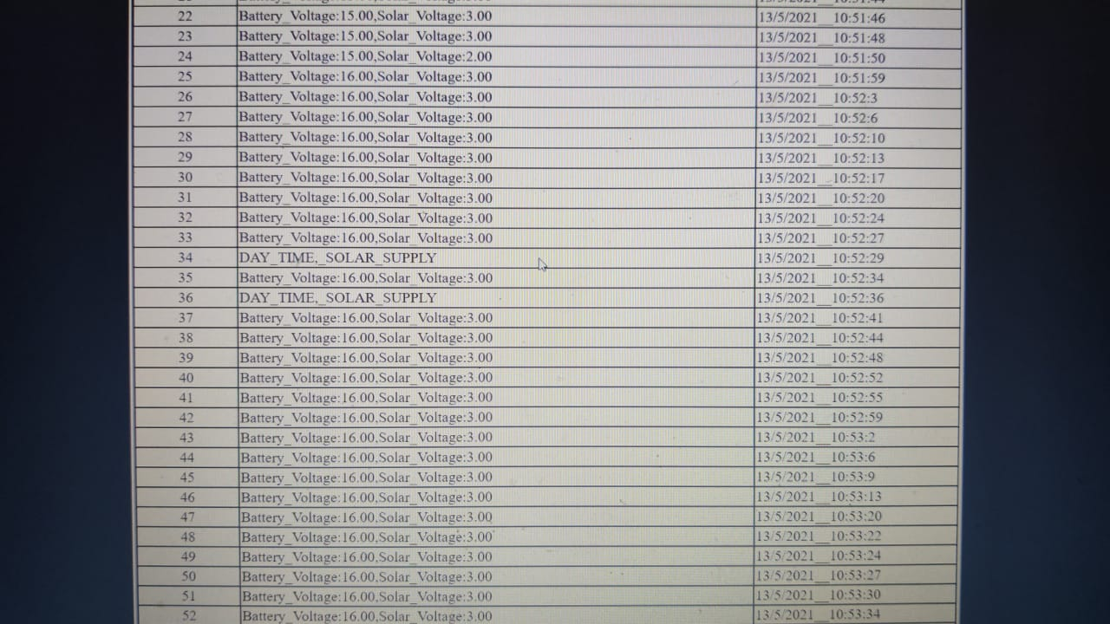

Slide 28
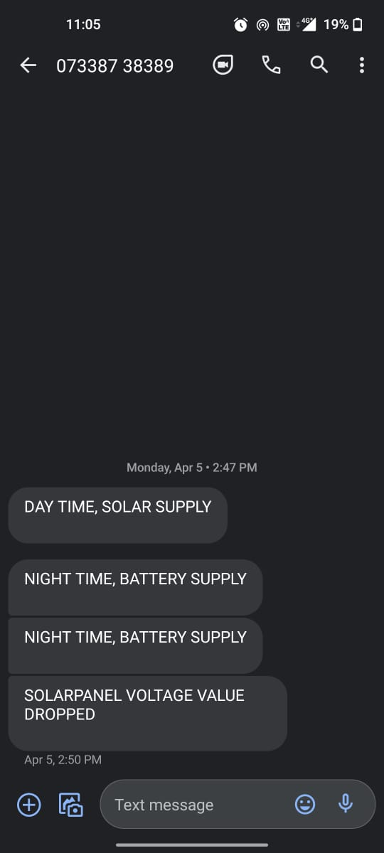

Slide 29
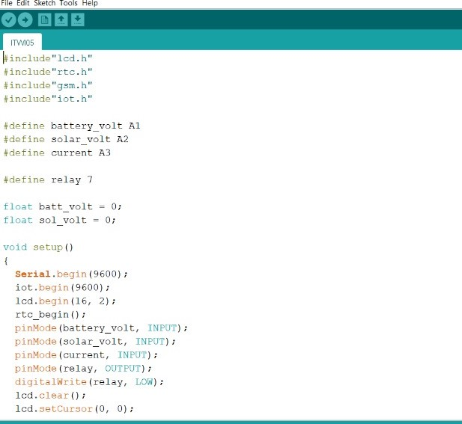
PROGRAM:

Slide 30
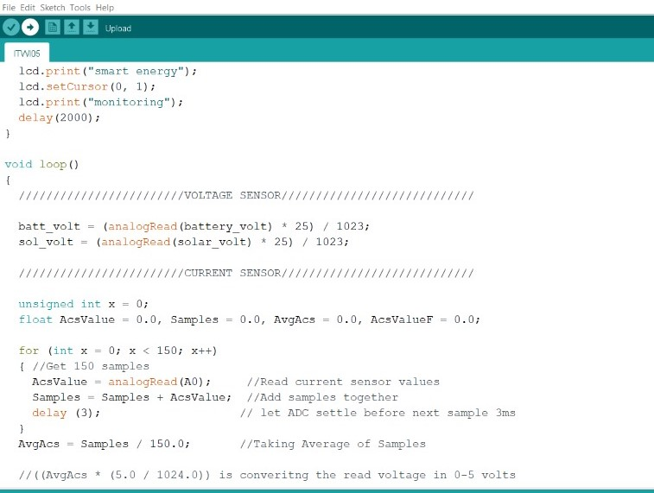

Slide 31
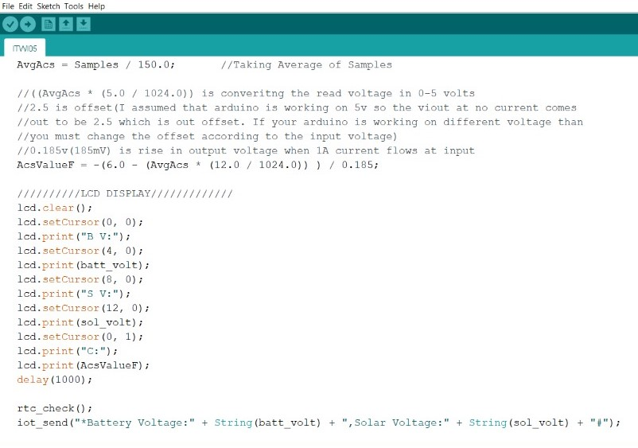

Slide 32
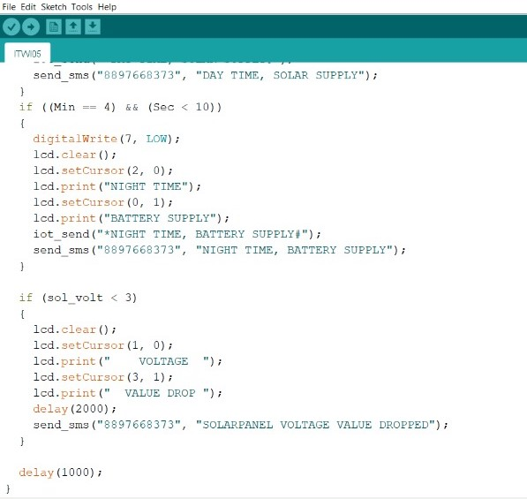

Slide 33
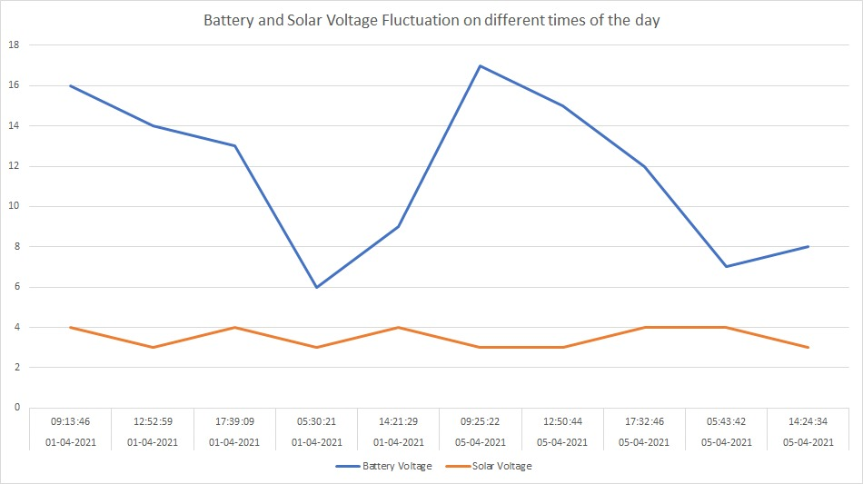
OUTPUT GRAPH:

Slide 34
Drive Link for the Project Demo
https://drive.google.com/file/d/1PfDmRNowaX_hx6JLiAe_cepfWRQUKPEb/view

Slide 35
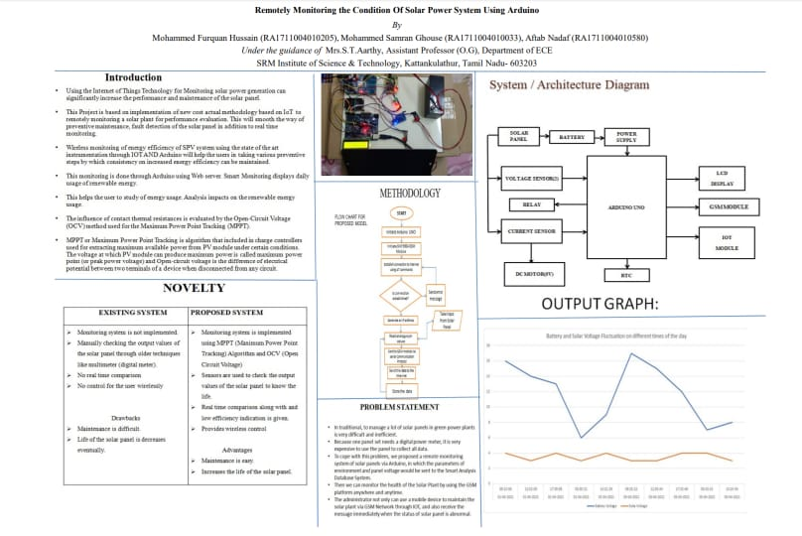
Poster

Slide 36
REFERENCES
[1] Ayushi Nitin Ingole, (2016)“Arduino based solar tracking system”, (ICSTSD) International Conference on Science and Technology for Sustainable Development.
[2] Balbheem Nadpurohit, Noopa Kulkarni, Kadappa Matager, Nagaraj Devar, Rahul Karnawadi,Edmund Carvalho,(2017) “IoT Enabled Smart Solar PV System”, International Journal of Innovative Research in Computer and Communication Engineering(IJIRCCE), vol. 5, issue 6.
[3] Byeongkwan Kang, Sunghoi Park,Tacklim Lee, and Sehyun Park,(2015)” IoT-Based Monitoring System using Tri-Level Context Making Model for Smart Home Services”, IEEE International Conference onConsumer Electronics (ICCE).
[4] Marijana Vidas-Bubanja (2014) “Implementation of Green ICT for Sustainable Economic Development”, International Conference on Control, Instrumentation, Energy & Communication (CIEC)

Slide 37
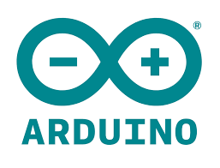
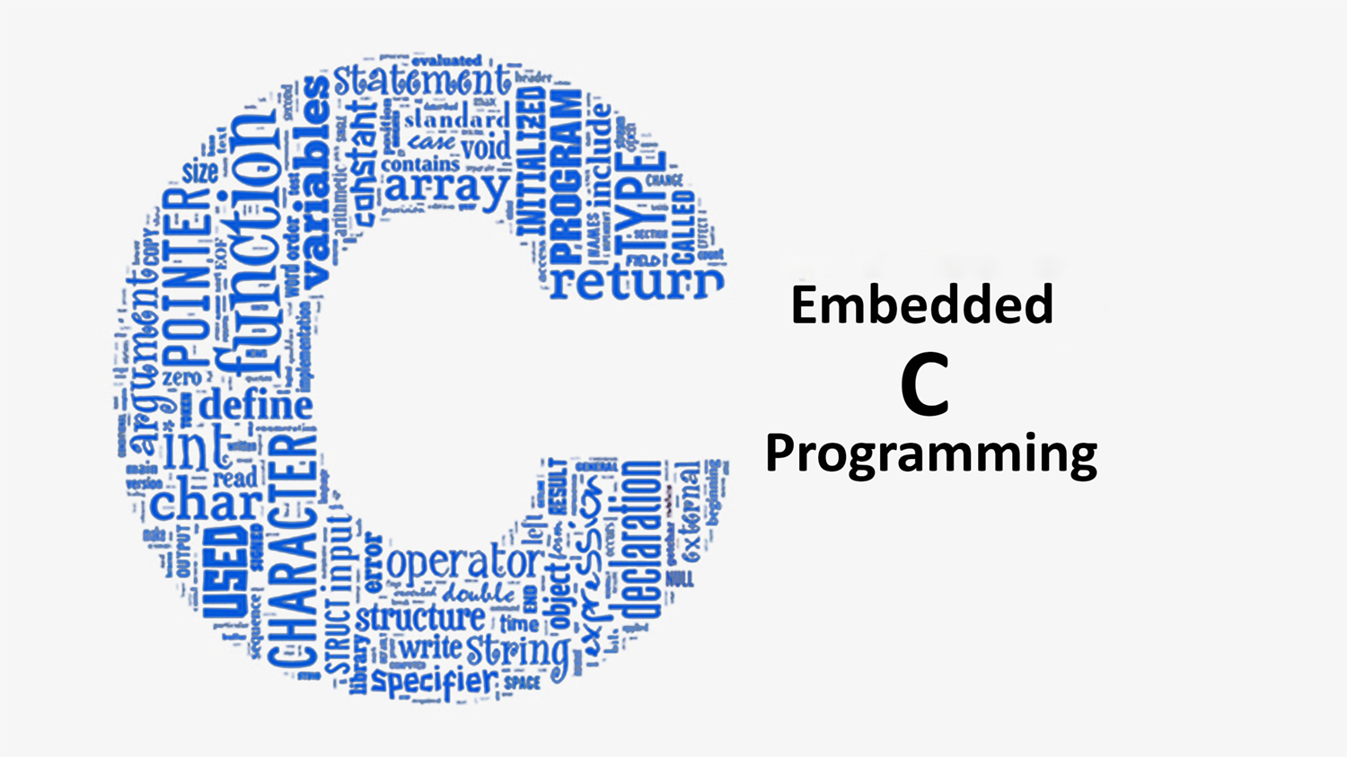

THANK YOU

